Slide 1



AngularJS Best Practices
High Quality SPA Applications
SoftUni Team
Technical Trainers
Software University
http://softuni.bg

Slide 2


Table of Contents
File & Folder Organization
Organizing Modules
Naming Conventions
Controllers, Services, Directives Roles
Dealing with Scope
Communication between components
Breaking page into components

Slide 3
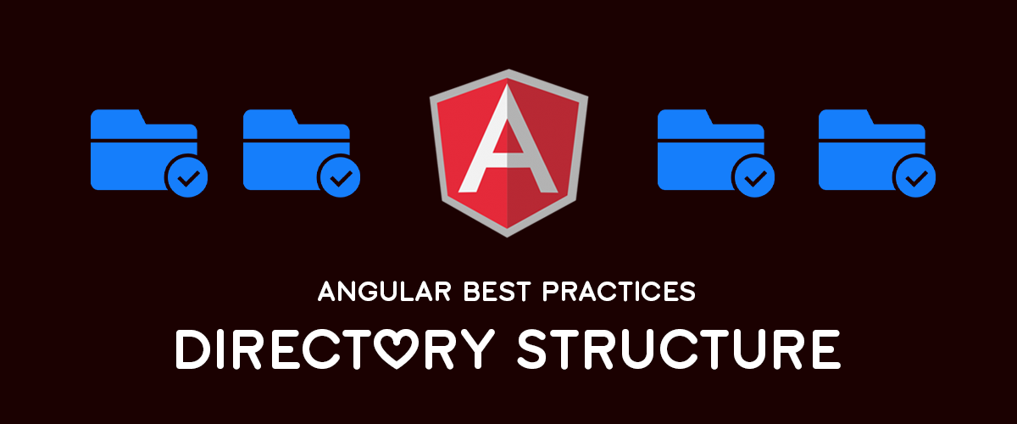
File & Folder Organization
How to structure Angular code?

Slide 4
File Organization – Angular Seed
Angular Seed
/components
viersion-directive.js
interpolate-filter.js
/view1
View1.html
View2.js
/view2
app.css
app.js
index.html
By Type
/js
/controllers
/services
/filters
/directives
app.js
/partials
/styles
index.html

Slide 5
File Organization – Angular Seed
By Feature
/authentication
/ads
publicAdsCtrl.js
adsDataSvc.js
publicAds.html
/profile
/styles
index.html
By Feature then Type
/authentication
/ads
/controllers
publicAdsCtrl.js
/services
adsDataSvc.js
/partials
publicAds.html
/styles
index.html

Slide 6
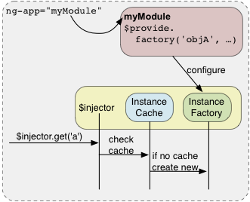
Dealing with Angular Modules
What are modules and how to use it?

Slide 7
Angular Modules
Modules are NOT containers for the objects in your application
Modules does NOT provide a sort of namespacing
Angular is creating an injector
The injector is the namespace for the objects
There is only one injector for a given Angular application
Only one object of a given name can exist in the injector

Slide 8
Angular Modules - Example
angular.module('app1', ['app2', 'app3']);
angular.module('app2', []);
angular.module('app3', []);
angular.module('app2').controller('Ctrl1‘, function($scope) {
$scope.name = 'Ctrl1 in App2';
});
angular.module('app3').controller('Ctrl1‘, function($scope) {
$scope.name = 'Ctrl1 in App3';
});
Prints: Ctrl1 in App3
<body ng-app="app1">
<div ng-controller="Ctrl1">{{name}}</div>
</body>

Slide 9
Angular Injector
Injector
Module1
Ctrl1
Ctrl2
Service1
Directive1
Module2
Ctrl3
Ctrl4
Service2
Directive2

Slide 10
Organizing Modules
One module
Two modules
Multiple modules
Module
MainModule
CommonModule
MainModule
SubModule1
SubModule2
SubModule3

Slide 11

Naming Conventions

Slide 12
Naming Conventions
Controllers
schedule or scheduleCtrl
Services
schedule or scheduleSvc
Filters
rating or ratingFilter
Directives
smallSchedule or smallScheduleDrct or small-schedule
Partials
schedule - schedule.html or scheduleDisplay.html

Slide 13

Components Responsibilities
Design guidelines for different components

Slide 14
Components Responsibilities
Controllers
Setup the Scope
View Interaction
Coordinate view and model
Services
Handle non-view logic
Communicate with the server
Hold data and state
Directives
Manipulate DOM
Receive view events
Views
Display the application
Declare bindings & directives

Slide 15
Design guidelines
Your components should do only what is responsible for
Services
Single Responsibility Principle
Cohesive
Loosely Coupled
Good Interface
Testable

Slide 16
Design guidelines
Controllers
Coordinate view and model
Directives Purposes
Widgets
DOM Events
Functionality

Slide 17

Dealing with the Scope

Slide 18
Scope Overview
Angular always starts with the Root Scope
All scopes in application are in hierarchy
All scopes belong to exactly one element
Relationship types
Shared scope
Inherited scope
Isolated scope

Slide 19

AngularJS Batarang – Chrome Extension
Live Demo

Slide 20
Creating different scopes
Sharing Scope
Inheriting Scope
Isolating Scope
Live Demo

Slide 21
Communication Between Components
Inherited Scope
Everything defined in parent scope is available in child scopes
Communicating with Events
Communicating with Services
$scope.$on('categoryClicked‘, function(event, category) { });
$rootScope.$broadcast('category:clicked', category);
$scope.clicked = function(category) { categorySvc.clicked(category) }
$scope.categories = categorySvc.getFilteredCategories();

Slide 22
Breaking Page Into Components
Inline controllers – ngController
ngInclude & ngController
Directives
<div ng-controller="sidebarCtrl"> … </div>
<div ng-include="'sidebar.html'" ng-controller="sidebarCtrl"> … </div>
<side-bar></side-bar>
app.directive('navBar', function() {
return {
restrict: 'E', templateUrl: 'sidebar.html', controller: 'sidebarCtrl'
}});

Slide 23
Avoiding FOUC in Views
Flash Of Uncompiled Content
Avoiding FOUC
ngCloak – Put it only at elements with bindings (not at body)
ngBind – Add &nbsp; in bind elements (don’t leave them empty)
Waiting image
<img src="spinner.gif" ng-hide="true" width="100px" />
<div ng-cloak><h1 ng-bind="person.name">&nbsp;</h1></div>

Slide 24
Writing Valid HTML with AngularJS
Writing valid HTML can be important
Use only element and attribute forms of directives
Use data prefix if you are using attribute form of directives
<body data-ng-app="app">
<div data-ng-controller="sidebarCtrl">
<div data-categories></div>
</div>
</body>

Slide 25
Minification
Manually minsafe
Use array to declare your dependencies
Use ngMin – Utility that minsafe your code
Install ngmin
Minsafe you code
Minify your minsaved code
app.controller('mainCtrl', ['$scope', 'mySvc', function($scope, mySvc) {
$scope.data = mySvc.data;
}]);
npm install ngmin -g
ngmin app.js app.save.js

Slide 26









AngularJS Best Practices
https://softuni.bg/courses/spa-applications-angularjs

Slide 27
License
This course (slides, examples, demos, videos, homework, etc.) is licensed under the "Creative Commons Attribution-NonCommercial-ShareAlike 4.0 International" license
Attribution: this work may contain portions from
"SPA with AngularJS" course by Telerik Academy under CC-BY-NC-SA license

Slide 28





Free Trainings @ Software University
Software University Foundation – softuni.org
Software University – High-Quality Education, Profession and Job for Software Developers
softuni.bg
Software University @ Facebook
facebook.com/SoftwareUniversity
Software University @ YouTube
youtube.com/SoftwareUniversity
Software University Forums – forum.softuni.bg

